Slide 1
Inter-process synchronisation
Concurrent /Parallel Processes

Slide 2
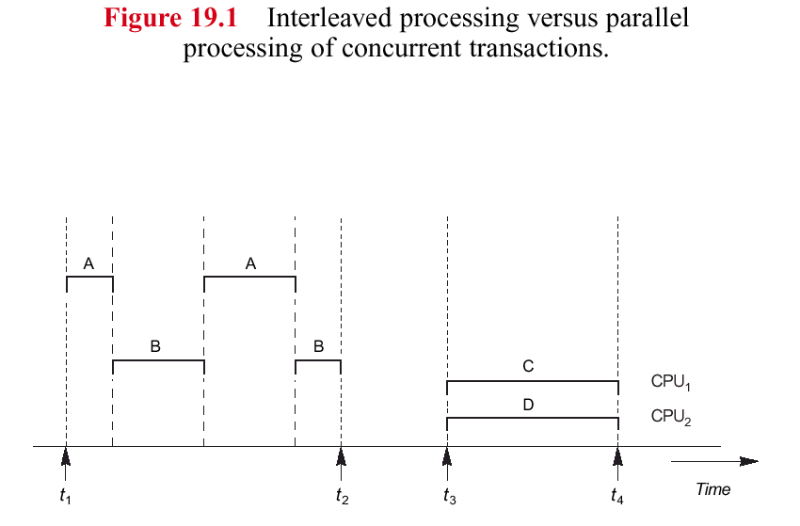
concurrency processing
Parallel processing

Slide 3
Why Concurrency Control?
However, concurrent transaction need to be carefully synchronised to:
to ensure the non interference or isolation property of concurrently executing transactions/processes.
Which can result in the so called RACE (Lost update) problem
This is achieved by protocols that employ locking, in which transactions/ process get exclusive access to a data item (critical region),

Slide 4
What is Parallel Processing?
Parallel processing
Two or more processors operate in one system at the same time
Work may or may not be related
Two or more CPUs execute instructions simultaneously (in parallel…)
Processor Manager
Coordinates activity of each processor
Synchronizes interaction among CPUs

Slide 5
Process Synchronization Software (cont'd.)
Critical region
Part of a program that must be executed in “one action”. (All or Nothing)
Other processes must wait before accessing critical region resources
Processes within the critical region
Cannot be interleaved otherwise
Threatens integrity of operation (all or nothing action)
5

Slide 6
Non Synchronisation example
if two processes or threads/transactions try to update the same object can result in: Race/lost update problem
Consider v = v + 1:
Thread A fetches v = 5 into a processor register within processor A
Thread B fetches v = 5 into a processor register within processor B
Thread B increments value in its processor register to 6
Thread B stores 6 into v
Thread A increments value in its processor register to 6
Thread A stores 6 into v

Slide 7
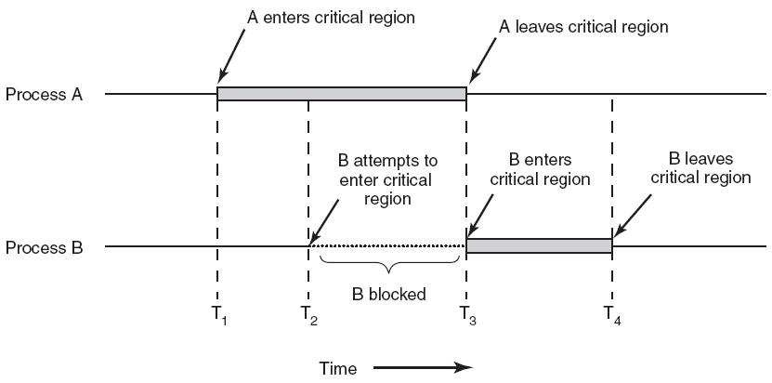
Critical regions of concurrent processes

Slide 8
Critical region (race problem)
In the previous example:
Step 1 occurs (fetch by process A)
Step 2 -4 must be blocked (fetch… update by B)
Step 5 and step 6 proceed. (update by process A)
Then steps 2-4 can proceed.
This ensures that the integrity of critical region (e.g. updating a register) is maintained.

Slide 9
Ensuring Process Synchronization
Synchronization
Implemented as lock-and-key arrangement:
Process determines key availability
Process obtains key
Uses it to lock access to critical region
Makes it unavailable to other processes
Types of locking mechanisms
Test-and-set
WAIT and SIGNAL
Semaphores

Slide 10
1 Test-and-Set
T.S Executed in single machine cycle
Test If key available: set to unavailable
Actual key often referred as the Mutex
Single bit in storage location: zero (free) or one (busy)
Before process enters critical region
Tests condition code using TS instruction
If No other process in region (key is zero)
Process proceeds
Condition code (key) changed from zero to one
P1 exits: code (key) reset to zero, allowing others to enter

Slide 11
Test and Set
Use a lock variable (mutex):
while (test_and_set(mutex) == 1) {
// do nothing
}
critical_section();
mutex = 0;
Requires an atomic test-and-set operation
If mutex value is 0 resets mutex to value 1
Does not enter the loop; goes to critical section()
Otherwise stays witihin the while loop resulting in what is referred to as busy waiting

Slide 12
Test-and-Set (cont'd.)
Advantages
Simple procedure to implement
Works well for small number of processes
Drawbacks
Busy waiting
Waiting processes remain in unproductive, resource-consuming wait loops
Starvation (will cover in more detail in next lecture)
Many processes waiting to enter a critical region
Processes gain access in arbitrary fashion

Slide 13
Creating Mutex in linux
Data Type: pthread_mutex_t
Mutex functions:
int pthread_mutex_init(pthread_mutex_t *mutex,
const pthread_mutexattr_t *attr);
int pthread_mutex_lock(pthread_mutex_t *mutex);
int pthread_mutex_unlock(pthread_mutex_t *mutex);
Important: Mutex scope must be visible to all threads!
Mutex1.c is a simple example

Slide 14
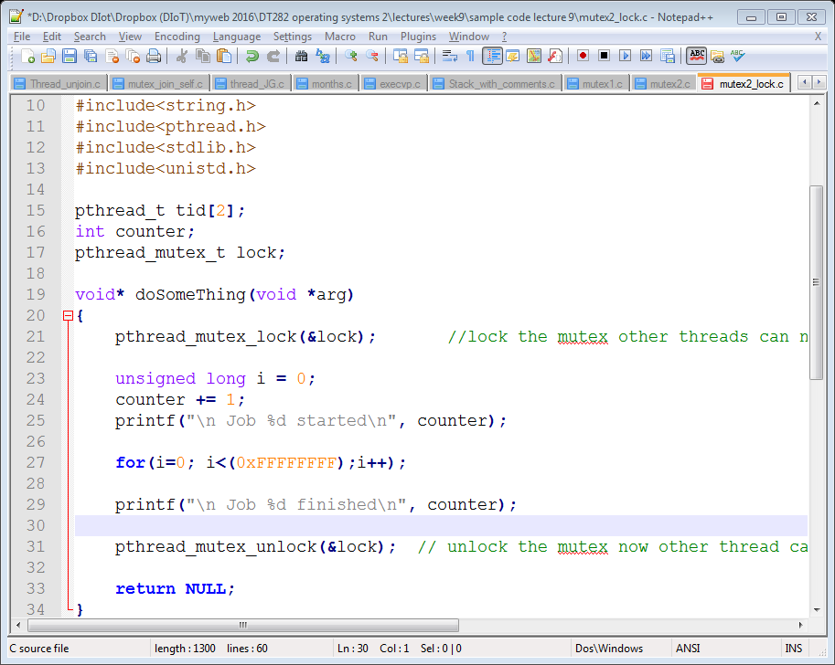
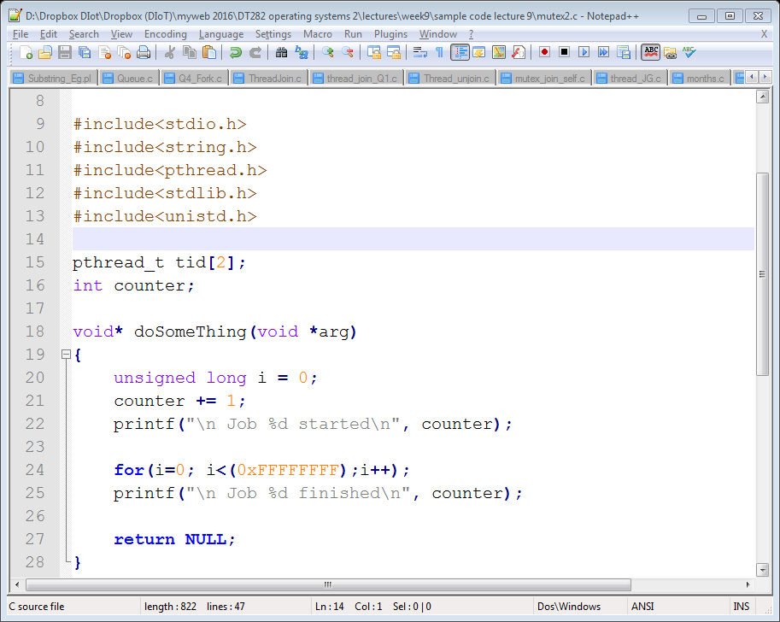
Test and Set example using Mutexs
Mutex2.c
Mutex2_lock.c

Slide 15
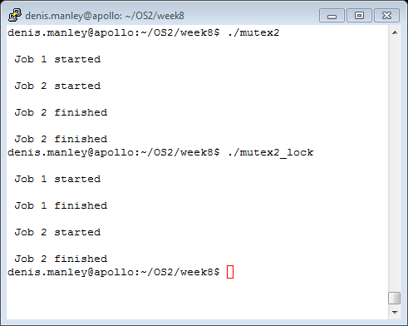
Sample output
Explain the different outputs

Slide 16
Example 2: mutex_join_self.c
#define NTHREADS 10
void *thread_function(void *);
pthread_mutex_t mutex1 = PTHREAD_MUTEX_INITIALIZER;
int counter = 0; // global
main()
{
pthread_t thread_id[NTHREADS];
int i, j;
for(i=0; i < NTHREADS; i++)
{
pthread_create( &thread_id[i], NULL, thread_function, NULL );
}
for(j=0; j < NTHREADS; j++)
{
pthread_join( thread_id[j], NULL);
}
printf(“ the final value of the counter is %d”, counter);
void *thread_function(void *dummyPtr)
{
printf("Thread number %ld\n", pthread_self());
pthread_mutex_lock( &mutex1 );
counter++; //mutex variable
pthread_mutex_unlock( &mutex1 );
}

Slide 17
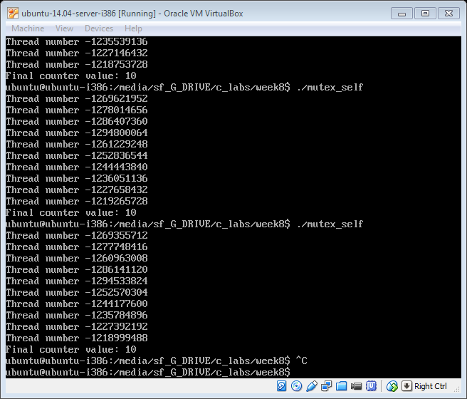
Question: Explain Sample output ?

Slide 18
Modify the “self” code
Count++; is equivalent to counter = counter +1;
Alternatively in 3 steps:
temp = counter;
Temp = temp +1;
Counter = temp;
Insert some processing between the steps: for (i=0…)
What do you think would happen if:
We kept lock/unclock
We removed lock/unlock
We remove unlock

Slide 19
2 WAIT and SIGNAL
A better synchronisation method: block process/thread until explicitly unblocked (wait and set)
This prevents a process/thread from running again until another thread signals that the situation (access to the critical regions) has changed
Two new mutually exclusive operations:
WAIT
Activated when process/thread encounters “busy” condition code and puts thread on the waiting queue and changes the status of its PCB/TCB (e.g. wait while counter is > 3 and counter is < 6)
SIGNAL
Activated if a process/thread encounters a condition “code” and sets mutex to “free”; signals processes/threads in waiting queue to run on the CPU. (signal if counter < 3 or counter >6)

Slide 20
“wait and set” Condition variables
Data Type pthread_cond_t
Create Functions:
int pthread_cond_init(pthread_cond_t *cond,
const pthread_condattr_t *attr);
int pthread_cond_destroy(pthread_cond_t *cond);
Waiting on condition
int pthread_cond_wait(pthread_cond_t *cond,
pthread_mutex_t *mutex);
Waking (set)
int pthread_cond_singal(pthread_cond_t *cond);
int pthread_cond_broadcast(pthread_cond_t *cond); (waking multiple threads)

Slide 21
Sample code: wait_signal.c
Signal fnt sample code
Wait fnt sample code
pthread_mutex_t count_mutex;
pthread_cond_t count_threshold_cv;
pthread_mutex_lock(&count_mutex);
count++;
if (count == COUNT_LIMIT) {
/
pthread_cond_signal(&count_threshold_cv);
}
pthread_mutex_unlock(&count_mutex);
pthread_mutex_lock(&count_mutex);
while (count < COUNT_LIMIT) {
pthread_cond_wait(&count_threshold_cv, &count_mutex);
count += 125;
pthread_mutex_unlock(&count_mutex);

Slide 22
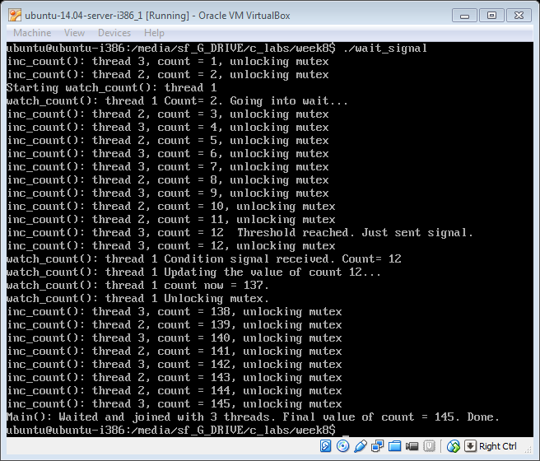
Explain output wait_signal.c. Remove wait and signal functions and explain output

Slide 23
Semaphores
The semaphore methods is a generalisation of the mutex (wait and signal)
has an integer value ≥ 0 (wait/signal it is 0 or 1)
wait operation: suspend if = 0, otherwise decrement by 1 and continue.
signal operation: increment (and notify any threads blocked on this semaphore)
Signals if/when a resource/critical region is free
Resource can be used by another process

Slide 24
3 Semaphores
Original terminology
Two operations of semaphore: proposed by Dijkstra (1965)
P (proberen means “to test”)
V (verhogen means “to increment”)
Where P is equivalent to Wait operation (waiting for semaphore to give the all clear to enter critical region)
V is like Signal indicating its free and selects next process to enter critical region

Slide 25
Semaphores (cont'd.)
Let s be a semaphore (mutual exclusive) variable
P(s): If s > 0, then s: = s – 1
Test, fetch, decrement, store sequence (test and set/wait signal)
V(s): s: = s + 1
Fetch, increment, store sequence (enter signal)
If s = 0 implies busy a process in critical region
A Process/thread calling on P operation must wait until s > 0
One leaving the critical region the V function is called
The V signals to “one” of the process in the waiting queue that the critical region is free and increment semaphore by 1

Slide 26
Semaphores in posix
Initalise semaphore:
sem_int (sem_t *sem, 0, unsigned int value)
sem_int(&sem_name, 0, 1)
sem)_int(&sem_name, 0, 0)
The 3rd parameter can be a number > 0: why?
Note 2nd number relates to shared mutexes and in Linux must be set to 0
P (wait) function is Sem_wait(sem_t *sem) ;
sem_wait(&sem_name)
If functions returns a negative value it blocks the process and must wait for the sem_post (V or signal to wake up)

Slide 27
Semaphores in posix
V : signal function or sem_post (sem_t *sem) ;
sem_post(&sem_name)
Increments the value of the semaphore and wakes up any process (thread) that is waiting
Other functions associated with semaphores are:
int sem_getvalue(&sem_name, &value);
printf(“the value of the semaphore is %d \n”, value);
sem_destroy (&sem_name);

Slide 28
A program using semaphores
To Run a semaphore program use:
gcc -o example example.c -lpthread –lrt
Link to semaphore basics

Slide 29
Semaphore_example.c
sem_t sem1, sem2;
void *thread1( void *arg ) {
sem_wait( &sem1 );
printf( "I'm in thread 1, postin ur semaphores\n" );
sem_post( &sem2 );
pthread_exit( NULL );
return NULL;
}
void *thread2( void *arg ) {
sem_wait( &sem2 );
printf( "I'm in thread 2, lol\n" );
pthread_exit( NULL );
return NULL;
}
int main( int argc, char **argv ) {
// initalise semaphore
sem_init( &sem1, 0, 1 );
sem_init( &sem2, 0, 0 );
pthread_t threads[ 2 ];
pthread_create( &threads[ 0 ], NULL, thread2, NULL );
sleep( 1 );
pthread_create( &threads[ 1 ], NULL, thread1, NULL );
pthread_join( threads[ 0 ], NULL );
pthread_join( threads[ 1 ], NULL );
sem_destroy( &sem2 );
sem_destroy( &sem1 );
return 0;
}

Slide 30
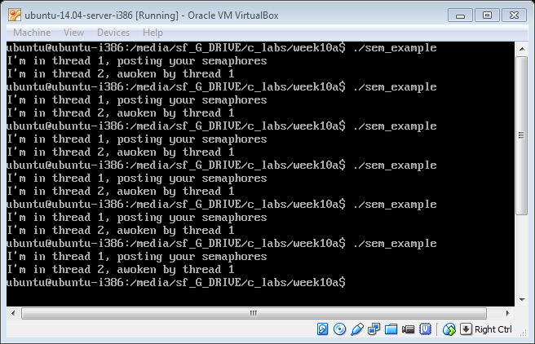
Semaphore_example .c

Slide 31
Semaphore examples with/without mutex:
A program using two threads to increment a global variable 10000.
The badcnt.c does not use semaphores and the result is not always 10000 (This is due to the race problem)
The goodcnt.c uses semaphores to lock the variable while being update by either thread and thus prevents the race problem. In this case the result is always 10000
Run these two programs in the lab and ensure you understand what is happening

Slide 32
Process Cooperation
Several processes work together to complete common task
Each case requires
Mutual exclusion and synchronization
Classical Example
Producers and consumers problem
Is implemented using semaphores
Used to “even out” speed differences between producers (e.g. PC) and consumers (e.g. printers)

Slide 33
Producers and Consumers
One process produces data
Another process “later” consumes data
Requires a bounded buffer to control differences in “speed” between both processes.
Example: CPU (producer) and printer buffer (consumer)
Delay producer if the “printer” buffer is full
Delay consumer: if buffer empty
Mutual exclusion to bounded buffer (can only add or remove from buffer at any one time)

Slide 34
Bounded buffers
Producer threads produce values, consumer threads consume them
Bounded buffer can hold up to N items
used to even out speed differences between producers and consumers
Next item to be read
Next space to be written to

Slide 35
Producers and Consumers (cont'd.)
Initialise Variables
empty: = n; full: = 0; mutex: = 1
Producers Algorithm:
{P x > 0; x = x - 1); (V x = x + 1}
Producer algorithm | Consumer Algorithm
Produce data | P(full)
P(empty) | P(mutex)
P(mutex) | # BEGIN CRITICAL REGION
#begin critical region | read item from buffer
write item into buffer | V(mutex)
V(mutex) | #END CRITICAL REGION
#END CRITICAL REGION | V(empty)
V(full) | Consume data

Slide 36
Example of producer and consumer
Using a single “bounder” buffer;
number of elements N = 12.
If empty =12 ; full = 0 (empty buffer)
What happens in producer algorithm?
What happens to consumer algorithm?
If empty = 0; full = 12 (full buffer)
What happens in producer algorithm?
What happens to consumer algorithm?

Slide 37
Bounded buffer code with bug which can cause deadlock
Initially itemsAvailable = 0, spaceAvailable = N
insert(Item i) { Item remove() {
p(spaceAvailable); p(mutex);
p(mutex); p(itemsAvailable);
doInsert(i); Item i = doRemove();
v(mutex); v(mutex);
v(itemsAvailable); v(spaceAvailable);
} return i; }
Explain why will this code cause a problem or end up in deadlock.

Slide 38
Parallel Programming
Another type of multiprocessing: one process uses multiple processors
Parallel processing system
One job uses several processors
Executes sets of instructions in parallel
Requires programming language and computer system support

Slide 39
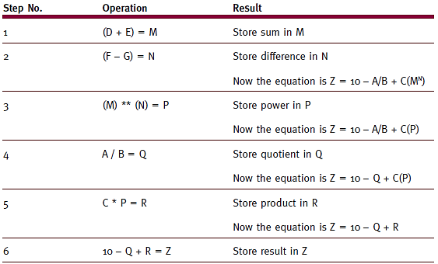
Parallel programming example
Z = 10 – A / B + C* (D + E) ** (F – G)
(table 6.5)
The sequential computation of the expression requires several steps. (In this example, there are six steps, but each step, such as the last one, may involve more than one machine operation.) © Cengage Learning 2014

Slide 40
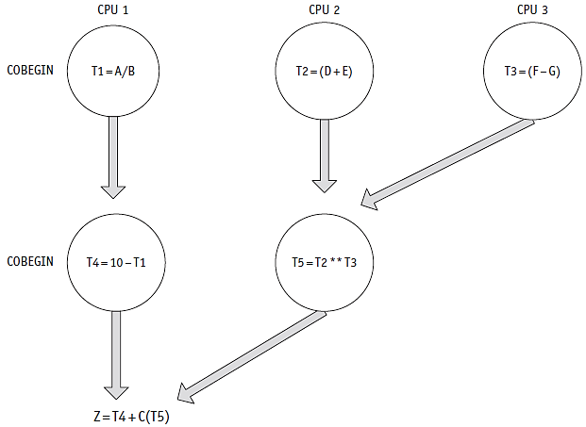
Parallel programming example
Z = 10 – A / B + C (D + E) ** (F – G)
(figure 6.9)
Three CPUs can perform the six-step equation in three steps. © Cengage Learning 2014

Slide 41
Applications of Parallel Programming
Other examples of reducing complexity via concurrent programming (using multiple CPUs): if operations can be performed independently !!!
Case 1: array operations
For (I = 0; I = 2; i++)
A[i] = B[i] + C[i]
Case 2: searching databases
Divide the database into sections and search each one for key

Slide 42
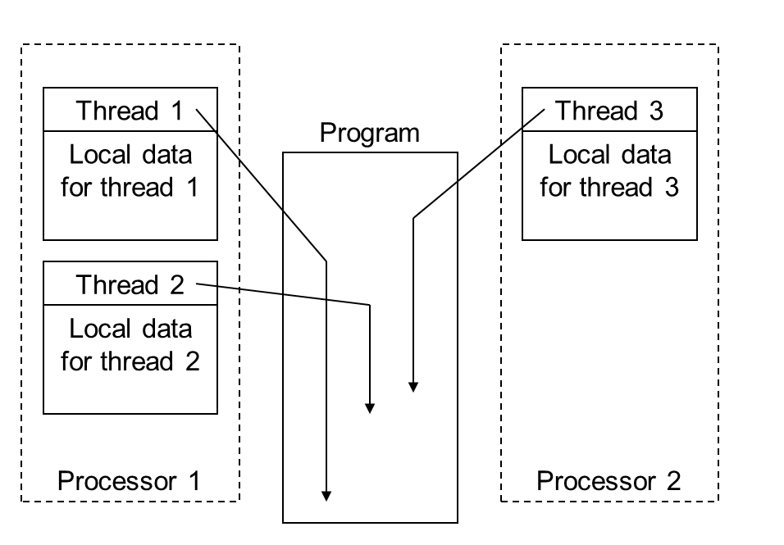
Threads and Parallel Programming

Slide 43
Threads and Concurrent Programming
If there is one CPU the threads can be processes concurrently.
If there are multiple CPUs threads they can be processes in parallel.

Slide 44
Sample Question
Explain why it is critical to ensure that concurrency is carefully controlled for processes accessing the same data item; in other words the race problem (6marks)
The test and set is an algorithm to prevent the race problem. What is the main problem with this algorithm and explain how the wait and signal approach overcomes this problem (6 marks)

Slide 45
Sample question
Threads use two functions to implement correct inter-process communication. What are the two functions and illustrate, with a suitable example how they work to prevent interference between threads.
Or
Explain in detail how the wait and signal example works (note you will be given the code)(12 marks)
Give an example of the expected output explaining your answer (6 marks)

Slide 46
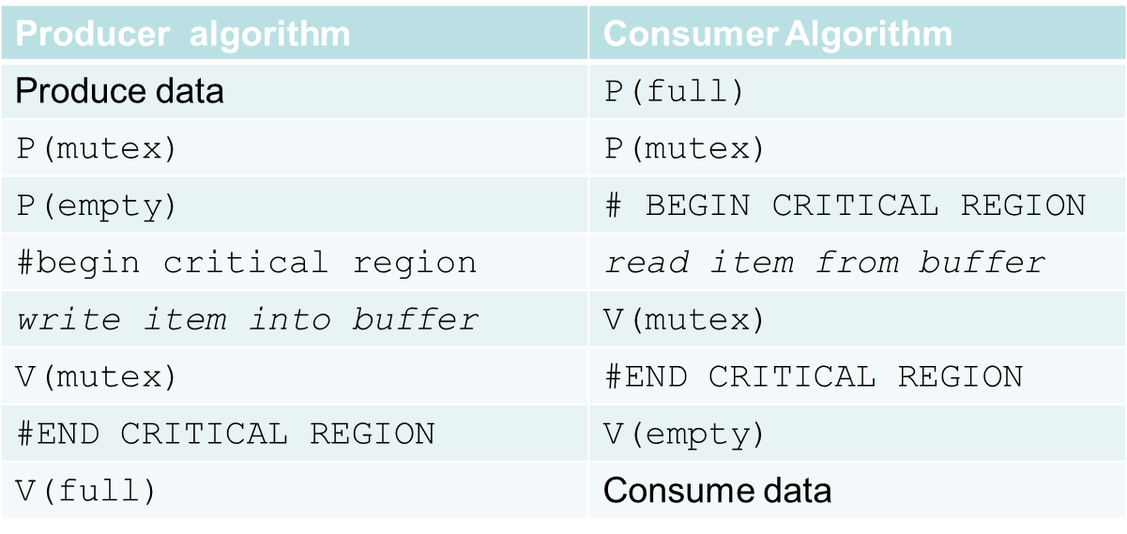
Sample question
Given the above pseudocode for the producer/consumer problem. Explain does this code prevent/result in deadlock (8 marks)

